Slide 1
Comparison of Automated
Unit Testing Tools
Research Project Presentation
CS9550A: Specifications, Testing, and Quality Assurance
Instructor: Prof. Kostas Kontogiannis
Aasminpreet Singh Kainth
Department of Computer Science
Middlesex College, Western University

Slide 2
Agenda
What is Unit Testing?
Why Bother Unit Testing?
Problem Description?
Motivation
Importance
Analysis Phases
Conclusion
LIMITATIONS AND FUTURE WORK

Slide 3
Unit Testing
a level of software testing where individual units/components of a software are tested.
The purpose is to validate that each unit of the software performs as designed.
A unit is the smallest testable part of any software. It usually has one or a few inputs and usually a single output.
In procedural programming, a unit may be an individual program, function, procedure, etc.
In object-oriented programming, the smallest unit is a method, which may belong to a base/ super class, abstract class or derived/ child class.

Slide 4
Why Bother Unit Testing?
There are many reasons why unit testing should be adopted for any software engineering project. These reasons include:
Faster Debugging – Without unit testing, the time it takes to debug or resolve a functional test that may have failed takes a long time to track down.
Better Design and Documentation – Writing unit tests forces developers into thinking how their code is going to be used and has generally resulted in better design and even better documentation.
Better Feedback Mechanism – When all unit tests for a system are run as a whole, the state of the system as a whole can be measured.
Reduce Future Cost – Many studies have proved that it costs significantly more money to fix a bug found later in the release than earlier in the development. A good unit test suite will uncover basic bugs early on in the development cycle
Notes:
Faster Debugging – Without unit testing, the time it takes to debug or resolve a functional test that may have failed takes a long time to track down.
With unit testing however, the scope of the test is kept to a minimum, and the point at which a failure may be triggered can be isolated faster.

Slide 5
Problem Description
Some developers still do not do much unit testing. The possible reasons are:
Some developers do not think the time and effort will be worthwhile.
Unit tests must be maintained, and maintenance for unit tests is often not budgeted.
A third possibility is that developers may not know how to design and implement high quality unit tests.

Slide 6
Importance
Using automated unit test tools instead of manual testing can help with all three problems.
Automated unit test tools can reduce the time and effort needed to design and implement unit tests
These tools can make it easier to maintain tests as the program changes
Tools can encapsulate knowledge of how to design and implement high quality tests so that developers do not need to know as much.
But an important question that developers must answer is “which tool should I use?”

Slide 7
Motivation
Automation support for unit testing, in the form of various automation tools, could significantly lower the cost of performing unit testing phase as well as decrease the time developer involved in the actual testing.
The problem is how to choose the most appropriate tool that will suit developer requirements consisting:
cost involved,
effort needed,
level of automation provided,
language support, etc.

Slide 8
Analysis: Phase 1
The total number of tools found is 22, which includes all the domain, type of availability, etc. Out of 22 tools, I found 4 prototype tools.
AutoGen
Godzilla
SimC
Symclat
Prototype tools are developed by some educational group or researchers.
Most of them are not available for public use; because these tools are not completely developed to launch in the market.
Notes:
The main purposes of these tools are to test the new techniques developed for test data generation. These prototype tools only involve the idea to build the new tool.

Slide 9
Analysis: Phase 2
CATEGORIZATION OF TOOLS
Once I collected all the automation supported unit-testing tools. It is time to categorize them and put them into groups.
Based on Domain
Programming Language Support
Testing Technique
Availability of Tools

Slide 10
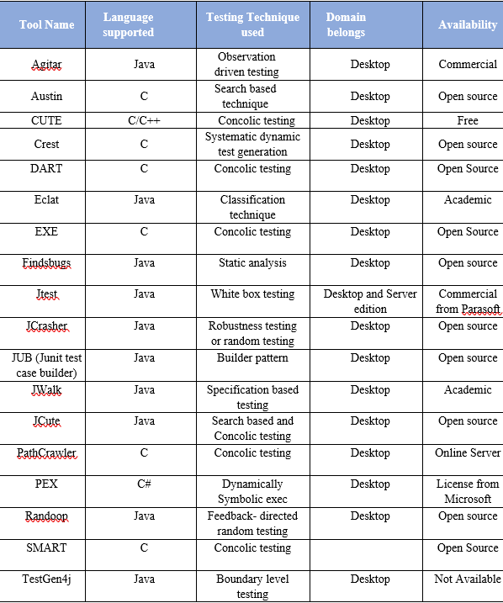
CATEGORIZATION OF TOOLS
Notes:
CUTE: A concolic unit testing engine for C
DART: Directed Automated Random Testing

Slide 11
CATEGORIZATION OF TOOLS
Based on Domain
Domain defines as the type of application that is possible to test with the tool.
The most common domains identified are Desktop and server based.
From table, most of the tools support only desktop-based applications.

Slide 12
CATEGORIZATION OF TOOLS
Based on Programming Language Support
Each tool has the support for at least one specific programming language.
The most common programming languages concluded form the table are Java and C.
Only one tool PEX has the support for Microsoft C#. All other’s either support Java or C.
CUTE is only tool with the support of both C/C++.

Slide 13
CATEGORIZATION OF TOOLS
Based on Testing Technique
It is interesting to see in table, that tools are based on many different type of testing technique, there is not any one testing technique that has dominated the list of tools.
Some testing techniques were found to be used by few tools such as “concolic testing” and symbolic execution.
Notes:
There are many testing techniques exist such as white-box, black box, path testing. All these collected tools in table are directly or indirectly based on any of them.
This part will help us to categorize the tools based on the testing techniques used by that particular tool.
Concolic testing is a hybrid software verification technique that performs symbolic execution, a classical technique that treats program variables as symbolic variables, along a concrete execution (testing on particular inputs) path.

Slide 14
CATEGORIZATION OF TOOLS
Based on Availability of Tools
Availability of tool makes big difference for someone who wants to use.
In the table, it can be seen that there are 2-3 commercial tools available such as Jtest, Agitar, etc.
Most of the tools are open source but unfortunately, some of them are not even available.
There are few examples of academic and licensed tools also like Eclat, PEX.

Slide 15
Analysis: Phase 3
TYPE OF ERRORS
This phase dealt with finding the type of error(s) that each tool can find.
The aim was to find the type of error(s) for each tool by reading the research papers instead of by trying them on some source code.
The reason I could not find the type of errors for some tools was the lack of research papers read.
Notes:
The type of error(s) mentioned for each tool is not the only errors that they can find, these are some most common errors that they can find and regularly discussed in the research papers

Slide 16
Tool Name | Type of Error(s)
CUTE | Error in mathematical calculation even inside nested statements; Unnecessary calls of same method; Results comparison with expected values; Null point exception and out of bound in array; Unused code Specialized rules (J2EE); Formatting in the code
DART | Program crashes; Assertion violation; Non termination; Memory allocation detect with collaboration with other run time checking tool
EXE | Constraint Solving; Independent constraint optimization; Bit-victor arithmetic
ECLAT | Out of bound Exception; Pre/post condition violation; Illegal inputs
Jcrasher | Robustness failure; Undeclared run time exception; Pre/Post condition violation Out of memory error; Analysis of exception for error
Jcute | Deadlocks; Uncaught Exceptions; Infinite loop
Jwalk | Unexpected interaction among methods such as dead ends on the fly, broken pre condition; Interleaved constructor
Path Crawler | Infinite loop detection; Pre/Post condition violation; Handling floating point numbers and arithmetic operations; Aliasing and pointer arithmetic
PEX | Argument exceptions; Out of bound in array; Arithmetic specification; Missing pre/Post conditions; Buffer overflow or Resource leak; Syntactic programming error
Randoop | Run time assertion violation; Runtime access violation; Missing messages in resource file and state of resource file; Memory management errors; Concurrency error such that related to test input
TYPE OF ERRORS

Slide 17
Tool Name | Type of Error(s)
CUTE | Error in mathematical calculation even inside nested statements; Unnecessary calls of same method; Results comparison with expected values; Null point exception and out of bound in array; Unused code Specialized rules (J2EE); Formatting in the code
DART | Program crashes; Assertion violation; Non termination; Memory allocation detect with collaboration with other run time checking tool
EXE | Constraint Solving; Independent constraint optimization; Bit-victor arithmetic
ECLAT | Out of bound Exception; Pre/post condition violation; Illegal inputs
Jcrasher | Robustness failure; Undeclared run time exception; Pre/Post condition violation Out of memory error; Analysis of exception for error
Jcute | Deadlocks; Uncaught Exceptions; Infinite loop
Jwalk | Unexpected interaction among methods such as dead ends on the fly, broken pre condition; Interleaved constructor
Path Crawler | Infinite loop detection; Pre/Post condition violation; Handling floating point numbers and arithmetic operations; Aliasing and pointer arithmetic
PEX | Argument exceptions; Out of bound in array; Arithmetic specification; Missing pre/Post conditions; Buffer overflow or Resource leak; Syntactic programming error
Randoop | Run time assertion violation; Runtime access violation; Missing messages in resource file and state of resource file; Memory management errors; Concurrency error such that related to test input
TYPE OF ERRORS
Most common errors that can be find by maximum tools are “out of bound” and “exception related errors”.
The pre/post violation is another common error that most tools can find.
PEX is the tool that can find maximum number of errors i.e. eight.
Notes:
It can be concluded that the tools are covering wide domain of errors.

Slide 18
Conclusion
Major contribution of the research work:
The list of tools and categorization table could be very useful for someone who wants to choose automated unit testing tool.
The categorization of all found tools explain the type of error(s) that can be found by some tools.
The table for categorization would be very useful in selecting the tool for industrial use.

Slide 19
LIMITATIONS AND FUTURE WORK
The following are the limitations and future work in the research:
The table in the paper contains some commercial tools, because of accessibility problem to these tools I could not provide the detailed information about them and especially type of error(s) that they can find.
The aim to provide the detailed comparison of some selected tools by applying them on open source could not achieved because of time constraint.
The idea to develop new tool by merging two three tools of similar kind that can find more range of errors.
Notes:
The detailed information related to each found tool. Currently I only provide the categorization of tools; the next step could be to take each tool explicitly and explain the detailed information of each one.

Slide 20
Questions?
Notes:
Concolic testing is a hybrid software verification technique that performs symbolic execution, a classical technique that treats program variables as symbolic variables, along a concrete execution (testing on particular inputs) path.
CUTE: A concolic unit testing engine for C
DART: Directed Automated Random Testing

Slide 21
Thank You.

